Slide 1
CORRELATIONS
Correlation: how strong is the (statistical) relationship between two variables?
describes, not explains the relationship between two variables
tells us nothing about cause-and-effect
If var1 and var2 have a strong, positive correlation
This does not mean that an increase in var2 causes an increase in var1 or vice versa
This simply means that as var1 increases, var2 also tends to increase
Correlation can be negative, positive, or minimal/zero
Correlation coefficient calculation methods:
(1) Pearson’s (measures only linear relationship)
(2) Spearman’s Rank (can measure non-linear relationships as well)

Slide 2
CORRELATIONS
Correlation coefficient, r:
Ranges between -1 and 1
|r| >= 0.7 suggests “strong” relationship
Keep in mind: relationship and strength of it, not slope of relationship
Coefficient of determination, R²:
Is (correlation coefficient)²
Ranges between 0 and 1
R² > = 0.5 suggests “strong” relationship
Interpretation: proportion of the variability of x that is described (linearly) by y

Slide 3
PEARSON CORRELATION
Most commonly used
Only detects linear relationships
Not robust - may miss strong non-linear relationships!
Interpretation: "strong" relationship means variables vary together, at a constant rate
Caveat: If your data isn't ~normally distributed, your p-values may not be as meaningful

Slide 4
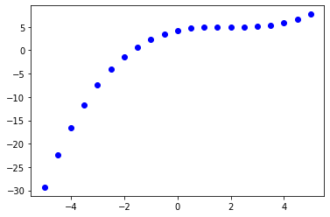
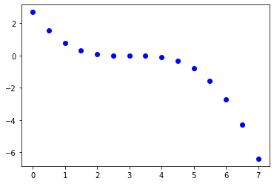
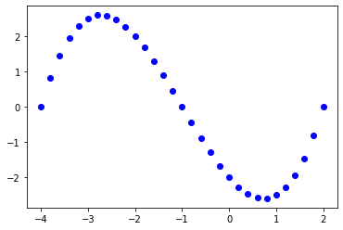
SPEARMAN'S RANK CORRELATION
Spearman’s, unlike Pearson’s, can well-capture non-linear, monotonic (consistently increasing or decreasing) relationships
Monotonically increasing
Monotonically decreasing
Not monotic
Pearson: 0.85
Spearman's: 1.0
Pearson: -0.89
Spearman's: -1.0
Pearson: -0.79
Spearman's: -0.77

Slide 5
SPEARMAN'S RANK CORRELATION
Other advantages: may also better handle data with outliers and/or skewness
Conceptually: rank values in each variable, then take the correlation of the ranked values
Interpretation: "strong" relationship means variables vary together, but not always at a constant rate
ALWAYS HELPFUL TO VISUALLY EXAMINE YOUR SCATTERPLOT FIRST!

Slide 6
STATISTICAL SIGNIFICANCE
Hypothesis testing: Testing an effect or difference between two populations of data using a sample from each population
Examples of effect: benefit, relationship, effectiveness
Null hypothesis: there is no effect or difference between these two populations
Here, null hypothesis = there is no linear relationship between two variables: r = 0
We hope to reject the null hypothesis
P-value less than < 0.05: there is sufficient evidence from this sample of data to reject this null hypothesis for the entire population and the correlation coefficient (and the relationship it represents) are statistically significant

